Slide 1
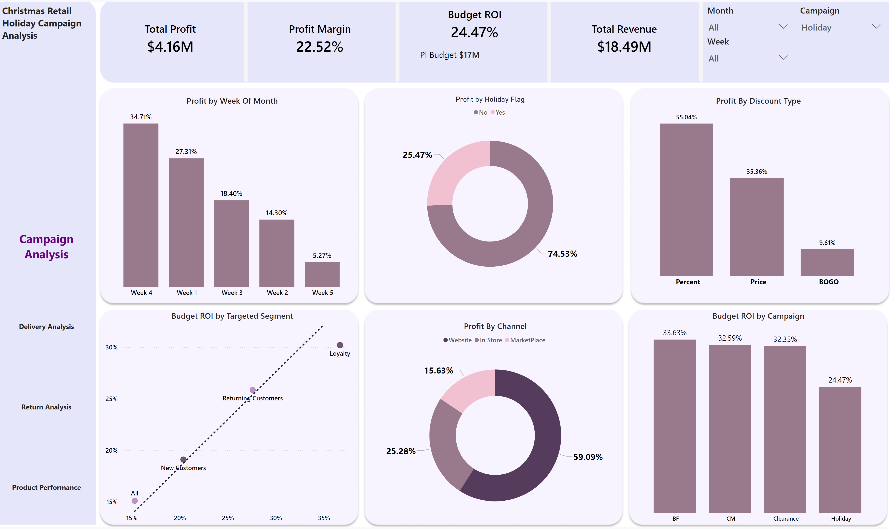
Campaign Analysis
Notes:
cardVisual
No alt text provided
slicer
No alt text provided
Budget ROI by Targeted Segment
No alt text provided
Profit By Discount Type
No alt text provided
Profit by Week Of Month
No alt text provided
Budget ROI by Campaign
No alt text provided
Profit by Holiday Flag
No alt text provided
cardVisual
No alt text provided
cardVisual
No alt text provided
cardVisual
No alt text provided
Profit By Channel
No alt text provided
textbox
No alt text provided
slicer
No alt text provided
slicer
No alt text provided
pageNavigator
No alt text provided

Slide 2
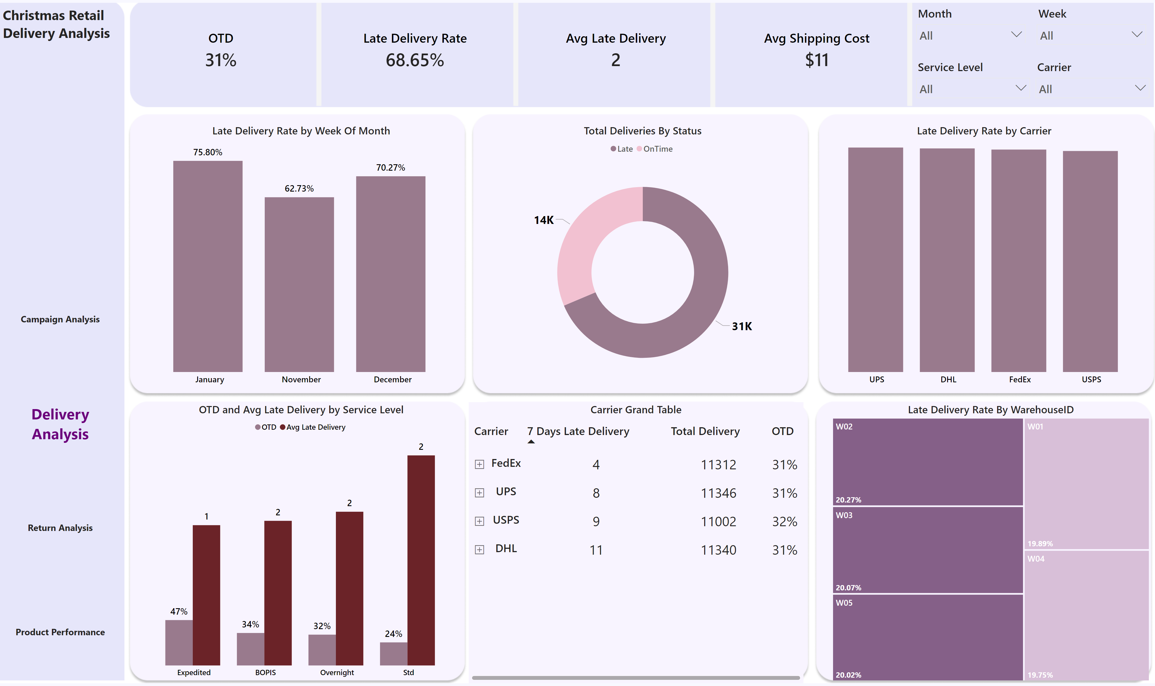
Delivery Analysis
Notes:
textbox
No alt text provided
slicer
No alt text provided
slicer
No alt text provided
cardVisual
No alt text provided
clusteredColumnChart
No alt text provided
Late Delivery Rate by Week Of Month
No alt text provided
Late Delivery Rate By WarehouseID
No alt text provided
Total Deliveries By Status
No alt text provided
OTD and Avg Late Delivery by Service Level
No alt text provided
Carrier Grand Table
No alt text provided
slicer
No alt text provided
slicer
No alt text provided
cardVisual
No alt text provided
cardVisual
No alt text provided
cardVisual
No alt text provided
pageNavigator
No alt text provided

Slide 3
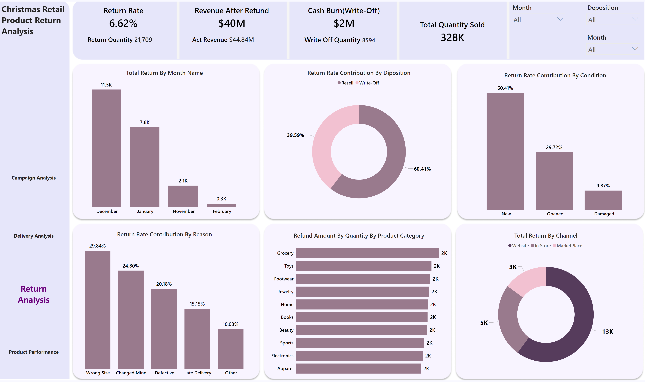
Return Analysis
Notes:
cardVisual
No alt text provided
Return Rate Contribution By Diposition
No alt text provided
slicer
No alt text provided
cardVisual
No alt text provided
cardVisual
No alt text provided
cardVisual
No alt text provided
Total Return By Month Name
No alt text provided
Return Rate Contribution By Condition
No alt text provided
Return Rate Contribution By Reason
No alt text provided
Refund Amount By Quantity By Product Category
No alt text provided
Total Return By Channel
No alt text provided
slicer
No alt text provided
slicer
No alt text provided
textbox
No alt text provided
pageNavigator
No alt text provided

Slide 4
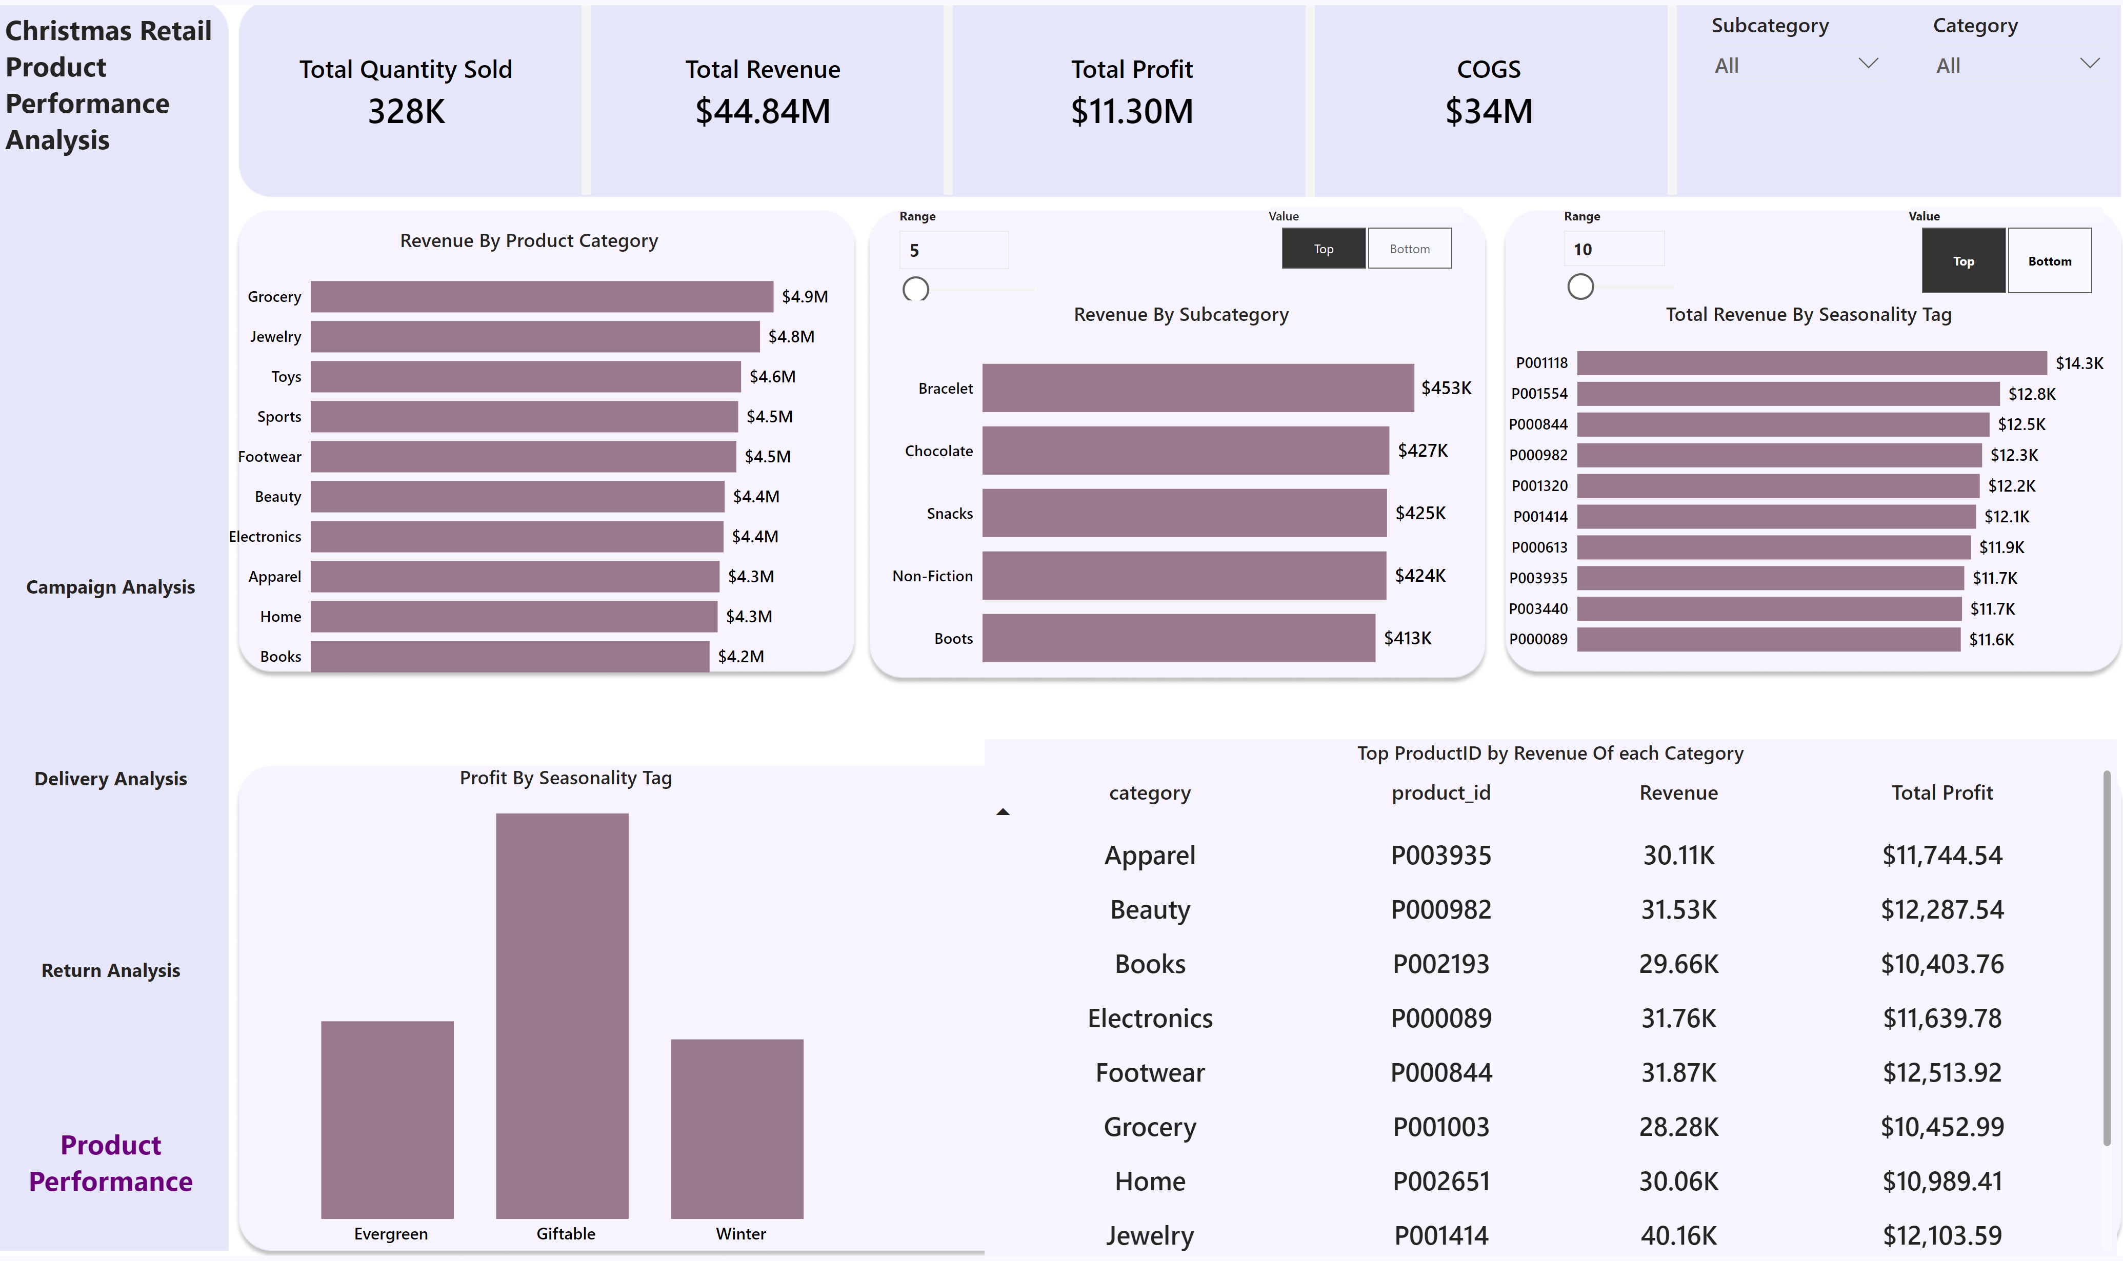
Product Performance
Notes:
cardVisual
No alt text provided
slicer
No alt text provided
cardVisual
No alt text provided
cardVisual
No alt text provided
cardVisual
No alt text provided
Revenue By Product Category
No alt text provided
Revenue By Subcategory
No alt text provided
Total Revenue By Seasonality Tag
No alt text provided
Sort
No alt text provided
slicer
No alt text provided
Top ProductID by Revenue Of each Category
No alt text provided
slicer
No alt text provided
Profit By Seasonality Tag
No alt text provided
slicer
No alt text provided
slicer
No alt text provided
textbox
No alt text provided
pageNavigator
No alt text provided

